Slide 1

EAL guidelines for good practice for schools.
English and an Additional Language Team
Accessibility and Inclusion Service
AIS: Together we can make a difference
relationships ~communication~teamwork~achievement~compassion
This Photo by Unknown author is licensed under CC BY-ND.

Slide 2
Our Mission Statement:
The AIS EAL team works in partnership with parents/carers, schools and other agencies to promote equality of opportunity through the process of inclusion.
Our work involves ensuring access to the curriculum, raising self-esteem and valuing bilingual children and young people’s linguistic and cultural backgrounds.

Slide 3
contents
Our team
Background information
Prioritising support
Our roles and responsibilities
Ensuring inclusion for new to English pupils
Direct teaching support
Partnership
Home language
Learning activities
Enrolment of new pupils
Early stages of learning English
The role of the bilingual assistant
Good practice – advice for teachers
Responsibilities for all

Slide 4
Our team

Slide 5
The EAL team:
Depute Head Teacher – Ruth McConnachie
Principal Teachers: Anne Ferrier and Moreen Milne
Teachers: Karolina Lewandowska, Gemma Soutar, Alison Wallace and Lynzy Mitchell
Early Years Educator: Karen Hendry
Bilingual Assistants

Slide 6
EAL team:
We are based at:
St Paul's Academy,
Gillburn Road,
Dundee.
Contact: 01382 438079/438099
Accessibilityinclusion@dundeeschools.scot

Slide 7
Background information

Slide 8
Our Aims
To support education staff in meeting the needs of bilingual children and young people.
To promote the welfare of bilingual children and young people within the school and the community so that they become successful learners, confident individuals, responsible citizens and effective contributors. (Scottish Executive - A Curriculum for Excellence)
To work in partnership with parents/carers, schools and other agencies to promote positive relationships.
To promote equality of opportunity and to fulfil the potential of children and young people by valuing their bilingualism.

Slide 9
Background – December 2022
Across the city of Dundee, there are a growing number of children in nursery, primary and secondary schools for whom English is not their first language.
Many children are part of the settled community and speak languages such as Arabic, Bengali, Polish, Punjabi or Urdu.
Over many years there has been an increase in the numbers of international workers arriving from Eastern European countries and settling with their families.
Furthermore, there are ‘short stay’ business and student communities, including asylum seekers and refugees, whose length of stay is uncertain and they have dependent children.
Currently, 92 languages, other than English, are spoken in educational establishments in Dundee.
In October 22, 1485 pupils were recorded as having English as an additional language.

Slide 10
Defining bilingualism
We describe all children, for whom English is not their first language, as bilingual, i.e. children and young people who function in more than one language in their daily lives.
The term ‘bilingual’ emphasises that we acknowledge they already have one language, and that English is an additional language. The term does not imply an equal or specified level of proficiency in two or more languages.

Slide 11
Language implications for new pupils
Bilingual children and young people may start school at any stage: nursery, primary or secondary and at any time throughout the school year. Some are immediately able to cope successfully, both socially and academically. Others, however, may be:
Beginners in English.
Children whose English has not yet fully developed.
Children who speak English fluently but may not be achieving their full academic potential.
Children who speak English but may experience difficulty adjusting to the Scottish Education System.

Slide 12
Responsibilities for all

Slide 13
Education Scotland - Inclusion
All Scotland's children and young people are entitled to support to enable them to gain as much as possible from the opportunities that Curriculum for Excellence provides. Some children may need additional support.
Targeted support:
Children and young people can benefit from additional or targeted support, tailored to their individual circumstances. This could be at any points of their learning journey or throughout the journey.
Barriers to learning may arise from specific learning difficulties, disability, social, emotional or behavioural needs, bereavement or family issues. Additional support may also be required to ensure progress in learning for the gifted and able, looked after children and young people, young carers, Gypsies and Travellers, asylum seekers and those for whom English is not a first language.
Targeted support also encompasses children and young people requiring more choices and more chances to achieve positive, sustained post-school destinations.
This 'targeted' support is usually, but not exclusively, delivered by staff with additional training and expertise. In a secondary school, this support may be coordinated by guidance/pastoral care/pupil support staff through a staged intervention process.

Slide 14
Getting it right for bilingual learners and their parents
All staff are responsible for meeting the needs of each learner, supported by EAL and bilingual local authority support services, as well as external agencies and community links.
It is important that parents or carers and the child or young person are involved in the learning journey at all stages of their education. Schools should have a positive and welcoming ethos.

Slide 15
Prioritising support
Tracking progress in English acquisition

Slide 16
Assessing Priority
The EAL team is an Outreach Service managed centrally. It is the policy of the EAL team to support bilingual children and young people according to their needs in collaboration with the school. When assessing a bilingual pupil's needs the following are taken into account:
Pupil's exposure to English
Pupil's English language proficiency (see Appendices –Stages of English Language Acquisition and Checklists)
Age and school stage
Previous educational experience
Areas of under-achievement
Length of stay (short stay are those who are here for up to 1 year)
Additional support needs
Previous experience of the school in supporting bilingual pupils
Exceptional circumstances (e.g. refugees)
On-going monitoring of the needs of pupils across the city is undertaken by the team and adjustments to the type and level of support offered is made where necessary.

Slide 17
Tracking and monitoring progress in English language acquisition
One of our main aims is to give bilingual children and young people access to the curriculum so that they can continue to develop cognitively while acquiring an additional language. English is best learned through the completion of meaningful tasks related to the curriculum.
Bilingual pupils make progress in acquiring English as an additional language in different ways and at different rates; however there are universally recognised broad stages in this development. All bilingual pupils in mainstream classes will be at one of these stages. It is generally accepted that progression from the first stage to a good command of ‘social ‘English takes 2 years and to fluency and a good command of ‘academic’ English takes a minimum of a further 5 years.

Slide 18
Tracking and monitoring progress – stages of English language acquisition
Stage 1 – new to English Stage
2- early acquisition Stage
3-developing competence
Stage 4-competent
Stage 5-fluent

Slide 19
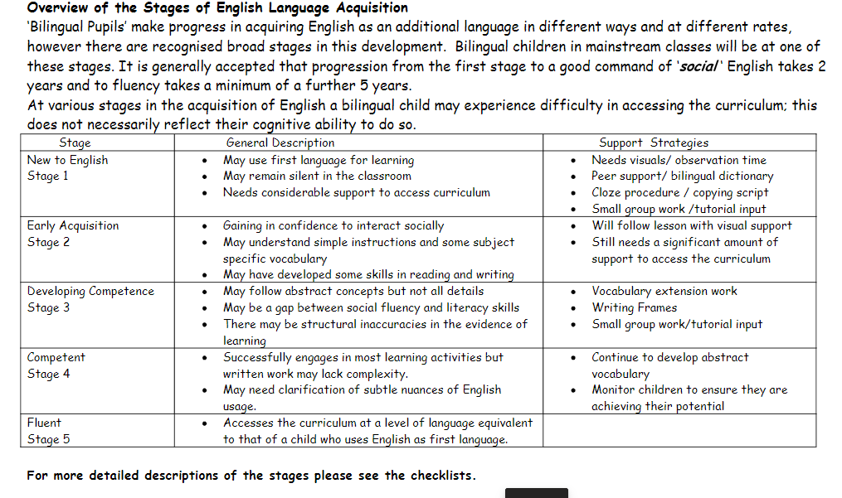

Slide 20
Tracking and monitoring progress in English language acquisition
The stage of English Language Acquisition is recorded for every bilingual pupil by the school, in addition to CfE levels of achievement. The stage of English Language Acquisition is transferred to SEEMIS for use in city-wide data collection and for use in the Scottish Executive census carried out in September. A single level stage is required for SEEMIS, scotXed and the EAL team even though learners may show characteristics of more than one level. It is important that this information is accurate.
EAL team members are available to support and advise throughout this process. Class/subject teachers can track and monitor progress by updating the checklists (see appendix) annually for their bilingual learners. The professional judgement of all staff working with the pupils, class- based evidence, including observation and any other assessment tools in use would support this process.
Information gathered through the annual EAL audit and completed by schools, provides evidence of pupils’ progress through the stages of language acquisition and allows the team to prioritise support.

Slide 21
Our roles and responsibilities

Slide 22
Roles and Responsibility
collaboration with schools/Dundee House to process placing requests for new arrivals to the city, transfers within the city, primary one intake and secondary transition (see appendices for a flowchart detailing procedure)
collaboration with schools to set up an enrolment meeting with parents/carers to exchange information regarding pupil background and education systems, using an interpreter and translated information where possible
on -going contact with parents / carers to provide home-school communication regarding pupil progress, school events, local community groups and classes
annual consultation in each school with a named school link person and an EAL teacher to review needs – each school has a link teacher from the EAL team

Slide 23
Roles and responsibility
supporting schools to provide accurate data on the Stages of English Language Acquisition for audits and the national census
advising schools and nurseries on suitable resources, learning and teaching approaches, strategies, exam arrangements and other exam opportunities for bilingual learners
direct support of identified pupils
providing citywide ESOL classes for senior pupils
maintaining links and developing partnership work with other agencies
providing in service training to education staff and other agencies
participating in DCC Education Department strategy groups

Slide 24
How we support additional language development
Involving Parents
Links with Other Agencies
In-Service Training
Collaboration on Target Setting and Assessment
Advising Schools on Appropriate Resources
Advising Schools on Differentiation of Resources
Direct Teaching/Partnership Teaching
Support in the Home Language
Collaborative learning /Co-operative Learning
We also aim to raise awareness among all children and staff of the diversity of Scotland’s population and the need to promote equality of opportunity.

Slide 25
Including parents
Schools will already have procedures in place for developing partnerships with parents/carers. However, additional issues need to be considered in the case of the parents/carers of bilingual learners.
Consider whether the underlying ethos of the school is welcoming and reflects Scotland as a multicultural, multilingual country.
Consider the enrolment interview as an opportunity to build trust and confidence in the school/nursery and encourage the involvement of parents in all aspects of school life. An interpreter should be present at the enrolment interview so that all parties can express themselves without fear of misunderstanding.
Parents should be made aware of how they can access school information.
Leaflets in a range of languages should be available via the school office or websites.
Consider whether parents who have come from a different education system understand the Scottish Education System, the curriculum, methodology, pastoral care and the key role of parents.

Slide 26
Links with other agencies
Schools will already have procedures in place to identify strategies to support children and young people, such as ABLe and will have established links with other agencies and organisations to support the educational and pastoral needs of all children. However, links may need to be supported with agencies in the case of bilingual children and young people.
Bilingual children may have other additional support needs, for example, a sensory impairment, a physical disability, social, emotional or behavioural difficulties or a specific language disorder. It is important to identify at an early stage any other additional need that is affecting academic or social development. Where the child is not making the expected progress it may not be clear whether this is because of accessing the curriculum through English as an additional language or because of a specific barrier to learning.
In such cases, we can facilitate links with appropriate agencies, the school and the parents for further assessment. For example, our Bilingual Assistants work alongside Speech Therapists, assessing overall language development in both languages and interpreting for parents.

Slide 27
Staff training opportunities
The EAL team can provide training suited to your school/nursery's needs.
This can be:
Whole staff presentations
Targeted group staff training
Collaboration with individual teachers to explore support strategies for a specific pupil/group of pupils
Self-study activities via the CLPL padlet
Citywide training via MyLearn
To arrange training – contact your link from the EAL team.
There is also an e-learning module – Valuing Bilingualism accessible to staff.

Slide 28
Ensuring inclusion for new to English pupils

Slide 29
Useful resources for children new to English
key visuals - e.g. tables, maps, diagrams - these provide information in a graphical rather than verbal form
pictures and photographs
artefacts and props
bilingual dictionaries
simplified texts and text summaries
adapted worksheets to allow children to read and write small chunks of information
texts in children's home language
audio-visual resources
games
ICT – apps and programmes such as Clicker
resources that reflect children's previous experience and background

Slide 30
Planning inclusive activities
Pair and small group work is vital, since whole class discussions are often inaccessible.
Understanding the scope and content of texts before reading gives a greater chance of making sense of the written word.
Photographs, drawings and diagrams convey meaning without reliance on text.
Labelling, matching and sentence completion provide text-reduced opportunities to show understanding of content.
Collaborative writing with other children who share the home language gives opportunities to take part in the composition process
Writing from a model or a ‘choice table’ gives the chance to use repetitive structures while using new vocabulary.
Sequencing simple sentences to give a factual account can then be linked to form a continuous piece of writing.

Slide 31
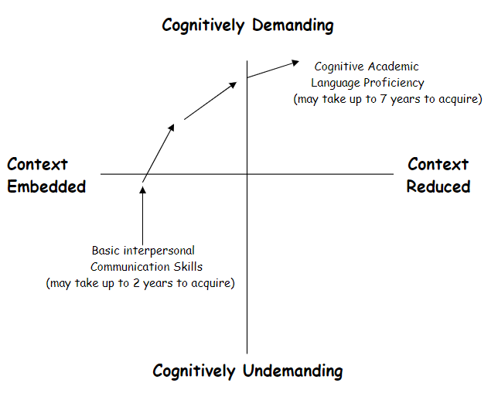
Making learning challenging
It is important to consider the level of English Language Acquisition when differentiating materials and approaches for children and young people new to English. However, consideration must also be given to the children's cognitive ability and prior attainment.
Bilingual children should have opportunities to experience different types of thinking ranging from cognitively undemanding such as naming, copying or identifying to cognitively demanding such as hypothesising, analysing or evaluating.
‘Cummins Quadrant’
Cognitively challenging activities should be well-contextualised so that children can start with existing knowledge and experience and move towards making sense of new learning.
(Cummins 1996) provides a useful tool for analysing classroom tasks

Slide 32
Direct teaching support

Slide 33
EAL team – direct teaching
Our team members work with bilingual learners in many different ways. The content of this input will be discussed with class or subject teachers and SFL staff with targets being set and records being kept.
Stage 1 New to English children may need to be taught very basic vocabulary and phrases in order to help them in their social English.
Stage 2 and 3 learners may need to learn some specific vocabulary and phrases which will be used in the mainstream class so that they are able to engage with the lesson and their peers.

Slide 34
EAL team direct teaching – ESOL provision
In Secondary schools the EAL staff deliver, assess and quality assure the SQA ESOL courses.
ESOL could be offered as a subject choice to those bilingual pupils in S4 and above who require the language support. This generally benefits their access to and understanding of other subjects on the curriculum.
In S5/6 NQ Higher ESOL can help bilingual pupils access University as it is a recognised English qualification.
https://sway.office.com/nDeFg8WC3Y6uXzxs?ref=Link

Slide 35
Partnership

Slide 36
Partnership with schools
This sway explains about the ways in which we can work with schools.
https://sway.office.com/ka9An3caxNqTCbgq?ref=Link

Slide 37
Teaching in partnership
We can support class/subject teachers with the planning for teaching bilingual learners, assessment and review of child progress.
A bilingual pupil may have differentiated materials, tasks and outcomes.
For good collaborative practice, joint planning time must be made available for school and EAL staff.
Within the classroom EAL staff may provide more explicit instruction and concept checking. Bilingual children and young people may have prior knowledge and learning which they are unable to communicate in English.
EAL staff can provide and highlight good models of English language and ensure the bilingual pupil has the opportunity for repetition and practice of the newly acquired language.
EAL staff may facilitate group work so that the bilingual pupil begins to learn from their peers.
Writing, speaking and note-taking frames may be incorporated into the lesson by the EAL staff to aid learning and help bilingual children to scaffold the language.
Bilingual children and young people are encouraged to use their L1 and bilingual dictionaries to support their learning.

Slide 38
Home language

Slide 39
Valuing the home language (L1)
The home language of the pupil should be valued by the school. As the pupil progresses through the stages of language acquisition, it is vital that the home language is maintained and developed.
A strong foundation in the home language is a major factor in enhancing the achievement and self-esteem of bilingual learners. Research also shows that learners, who develop an additional language, whilst their home language is strongly supported, experience definite cognitive benefits.

Slide 40
Using the home language (L1)
A strong foundation in the home language is a major factor in enhancing the achievement and self esteem of bilingual learners. Research also shows that learners, who develop an additional language, whilst their home language is strongly supported, experience definite cognitive benefits.
Home languages and culture should be given a positive place within our schools and parents should be encouraged to work in partnership in promoting and developing their child’s first language.
Children and young people who are new to English will be able to show their competence through their home language, particularly if they have literacy skills. Whenever possible, bilingual assistants who share the home language should support children so that they can display their skills and knowledge across the curriculum.

Slide 41
Using the home language (L1)
In addition there is much the school can do to maintain a positive ethos towards the use of the home language.
Encourage pupils to talk together in home languages
Value and praise bilingual competence
Treat heritage visits as a positive experience
Welcome home language support from bilingual staff
Encourage the use of bilingual dictionaries and word lists
Encourage literate pupils to read and write in their home language
Provide books written in different languages
Encourage children and young people to attend community language classes
Present senior pupils for home language examinations

Slide 42
Learning activities

Slide 43
Collaborative learning tasks
Information Gap: this is one of the simplest ways of encouraging pupils to interact. Using charts, graphs, timelines or text, one pupil has information that the other needs. They must ask and answer questions to complete the task.
Matching Activities: help pupils to explore thinking and language skills such as identifying, describing or defining cause and effect.
Sorting Activities: this type of activity encourages children to apply criteria and use the thinking and language of classification, generalising or defining a group.
Sequencing Activities: in order to complete a task pupils have to collaborate while thinking and talking about the order of events, instructions or descriptions of processes.
Ranking Activities: by organising items or people according to a given criteria, pupils are encouraged to evaluate, estimate, measure or judge while using the appropriate language required.
Collaborative learning activities were developed in the 1980s to provide opportunities for children and young people to use their own experience, ideas and abilities to make connections with ‘new learning’ and interact with other children and young people. They encourage children and young people to think and talk about subject matter in a reflective, problem-solving way. Collaborative learning activities maximise participation for all therefore giving bilingual learners a sense of belonging. Collaborative learning activities will include:

Slide 44
Co-operative learning
All co-operative learning should have the 5 basic elements
Positive Interdependence
Individual Accountability
Group Processing
Social skills
Face to Face Interaction
It may be that the bilingual pupil can contribute to the task in his/her home language or may have some skills or knowledge from their previous educational experience.
The team building exercises in co-operative learning should help the bilingual pupil feel confident enough to make a contribution. These elements will also contribute to the development of English Language Acquisition.
The language components of the activities and the role given need to be well planned for a bilingual pupil at the early stages of ELA.
Bilingual pupils will benefit linguistically from being part of the group both academically and socially.

Slide 45
Enrolment of new pupils

Slide 46
Admission procedures
For full procedure – see the flowchart
Best practice –
Check the home language spoken by the child.
If it is not English - Send the placing request to:
Your EAL link teacher
Accessibilityinclusion@dundeeschools.scot
Do not enrol the child without contacting your EAL link teacher.
All EAL pupils should be allocated a space in the appropriate year group for their age – regardless of level of English.

Slide 47
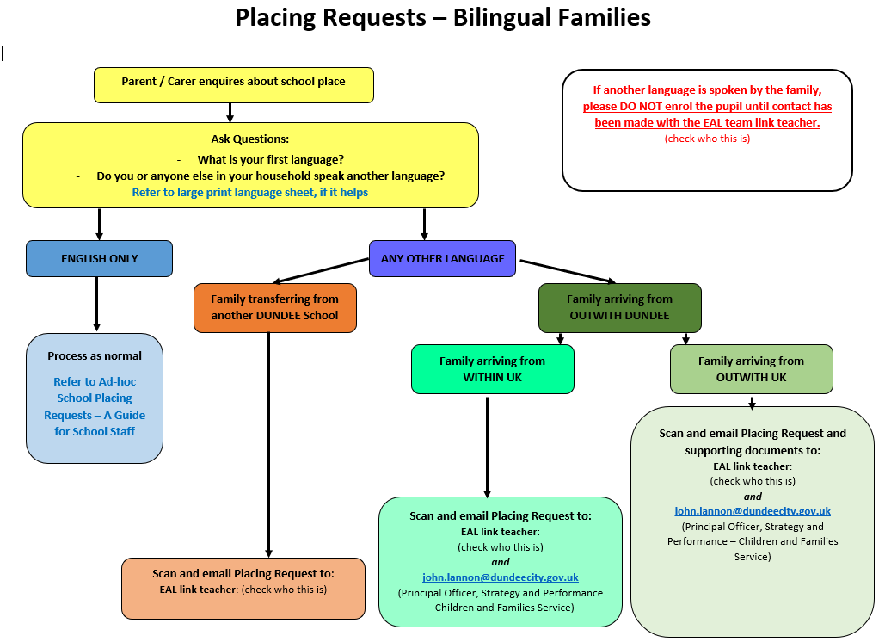

Slide 48
Enrolment Procedure for Bilingual New Arrivals
The enrolment process is the key to a smooth transition into school. It provides an opportunity to establish good home/school relations and develop confidence in parents, children and staff.
Arrange the enrolment meeting in partnership with your EAL teacher.
Your EAL teacher will:
Arrange an interpreter for the meeting.
Make contact with the family via the interpreter to agree a date for an enrolment meeting.
Attend the enrolment meeting and share key information from the checklist and support parents with data collection.
Collect background information about the pupils' prior learning to share with school staff.

Slide 49
Early stages of learning English

Slide 50
The Early Stages of Learning English
This outline of the development of young children's learning of English as an additional language draws on research findings. Although the process follows a particular sequence, it is flexible. Rather than moving through stages, think of the development in terms of waves - moving forward, receding, then moving forward again. (Olsen Edwards 1994)
Many children at the early stages of learning English go through a 'silent period'. This can last up to six months or longer. This is not a passive stage. Children will be listening and making sense of their new environment. They should not be pressurised to speak until they feel comfortable, however, adults should continue to talk to the children and involve them in activities.
During this wave, children may begin to use non-verbal gestures in response to questions or to indicate a need. Understanding is in advance of spoken language.
Many children may begin to 'echo' single words and short phrases used by adults and peers. All attempts at speech should be encouraged and praised.

Slide 51
The Early Stages of Learning English
There will be a development of 'formulaic' language (chunks of social speech) e.g. 'Mummy come soon', My turn'. Children may also begin to join in with story refrains and songs.
Chunking will continue, but children will increasingly begin to use one-word utterances (frequently nouns) which will perform a range of language functions. (e.g. questioning, responding, naming)
Children will then begin to generate their own 'telegraphic' sentences, using two or three word utterances. The main concern will be communication of meaning. Holistic phrases (a development of chunking) will continue during this wave.
Children will begin to use extended phrases or simple sentences which contain surface developmental errors in use of plurals, tenses, personal pronouns, function words and articles.

Slide 52
The Early Stages of Learning English
Increasingly children will develop more control in their use of functional language. Surface errors will continue until the children understand the use of different grammatical structures in the target language, which may be very different from the home language.
Adapted from NALDIC working paper 4: 'The early Stages of Learning English'

Slide 53
The Role of the bilingual assistant

Slide 54
The role of the bilingual assistant
Supporting Learning in the Classroom
1. Using the first language to
interpret teacher’s instructions.
help pupils complete tasks by redefining words and phrases critical to understanding in English or L1.
develop skills for learning (use of dictionary/developing vocabulary)
support conceptual development by oral explanation.
discuss any social /emotional issues
3. Contribute to pupil assessments and reports by feeding back to school staff on pupil progress.
2. Provide access to new learning by making links with previous learning, knowledge, home values and culture.

Slide 55
Supporting the Development of the First Language
A common underlying language proficiency (Dr James Cummins 1997) supports the development of both languages; first language proficiency supports the development of second language proficiency.
What to do -
encourage parental support;
develop transferable skills – sequencing, describing, giving reasons, asking questions etc.
develop thinking skills.

Slide 56
Supporting Home/School Liaison
provide support for parents at school events through interpreting information
home/school liaison including home visits for specific purposes.

Slide 57
Further ways bilingual assistants can support
Working in Collaboration with Other Professionals
Providing Cultural Background and Religious Information to the School
Contributing to Pupil Assessment (where appropriate)

Slide 58
Advice to Teachers-
Working with a Bilingual Assistant
Research shows that bilingual assistants are most effective when they are class-based and support ongoing class work rather than withdrawing pupils to support an alternative curriculum.
Working in a 1:1 situation has been shown to be less effective than group work. However, bilingual assistants may be required to work with individual bilingual pupils on subject-specific tasks that require tutorial type input.
Class and subject teachers have responsibility to plan for, teach and assess the needs and achievements of bilingual pupils.
Bilingual assistants will carry out tasks delegated to them by teachers to aid bilingual pupils to access the curriculum.
Bilingual assistants will consult and provide feedback to school staff at key points in the support process.
The majority of the bilingual assistants' time should be spent in contact with pupils and parents.

Slide 59
Good practice – advice for teachers

Slide 60
Advice to Teachers-
Good Practice in the Classroom
Concepts can be developed in any language; they do not have to be developed in English. Bilingual assistants in the classroom, parents and other pupils who share the same language can facilitate this type of learning.
Be a good model of spoken and written English, modelling the language for pupils to repeat. Be aware that pupils may go through a 'silent' period. This can last up to six months or longer. This is not a passive stage. Pupils will be listening and making sense of their new environment.
Collaborative group work gives pupils a supportive environment for communication and at the same time articulate pupils provide good models of language.
Facts and ideas conveyed through key visuals such as charts, diagrams and tables reduce the amount of language content while keeping the cognitive level appropriate.
Transforming information from one mode to another provides support for bilingual pupils to demonstrate learning, e.g. labelling a diagram, then using the labels to complete a chart, then using the chart as a basis for text.

Slide 61
Classroom Strategies for the Support of Bilingual Pupils
"Every teacher is a language teacher"
Create a supportive learning environment
Ask pupils to sit next to a good model pupil
Designate a buddy/buddies (and make their role clear)
Be consistent in classroom routines
Encourage use of bilingual dictionary / working with a partner who shares the first language
Be aware that some pupils may remain silent for some time. They are actively listening and observing.
Be aware that some pupils may become tired due to the considerable concentration required to access the lesson in an additional language
Be aware that pupils new to English will require longer thinking time.

Slide 62
Classroom Strategies for the Support of Bilingual Pupils
Consider the language and materials needed by pupils
Give direct instructions, speaking slowly and clearly
Consider your questioning style - be direct, ask one question at a time
Consider how you clarify and check understanding of the lesson with the pupil
Provide key words and phrases in various formats, e.g. On whiteboard, flashcards, glossaries
Ask literate bilingual pupil to record new vocabulary in a notebook
Model the language needed to complete tasks with speaking or writing frames.

Slide 63
Classroom Strategies for the Support of Bilingual Pupils
Present the lesson in a linguistically clear way
Present information both verbally and visually
Use graphics such as mind-maps, timelines, Venn diagrams, graphs and charts
Be aware that some pupils are not familiar with Roman script so write legibly on the board and handouts
Be aware that bilingual pupils at stages 1 and 2 may be confused by idioms or colloquial phrases; try to avoid using these to explain key concepts

Slide 64
Classroom Strategies for the Support of Bilingual Pupils
Plan activities and tasks which consolidate any newly learned language
Include all pupils by asking them questions appropriate to their linguistic ability, in order to boost confidence
Help pupils to analyse reading texts by asking them to highlight or underline key words and phrases
Organise groups to provide effective 'good' language and learning models for collaborative tasks
Use active listening activities such as listing 5 key points of a presentation
Encourage active oral participation. If pupil gives correct information but is grammatically wrong, repeat the answer in the correct form.

